Slide 1


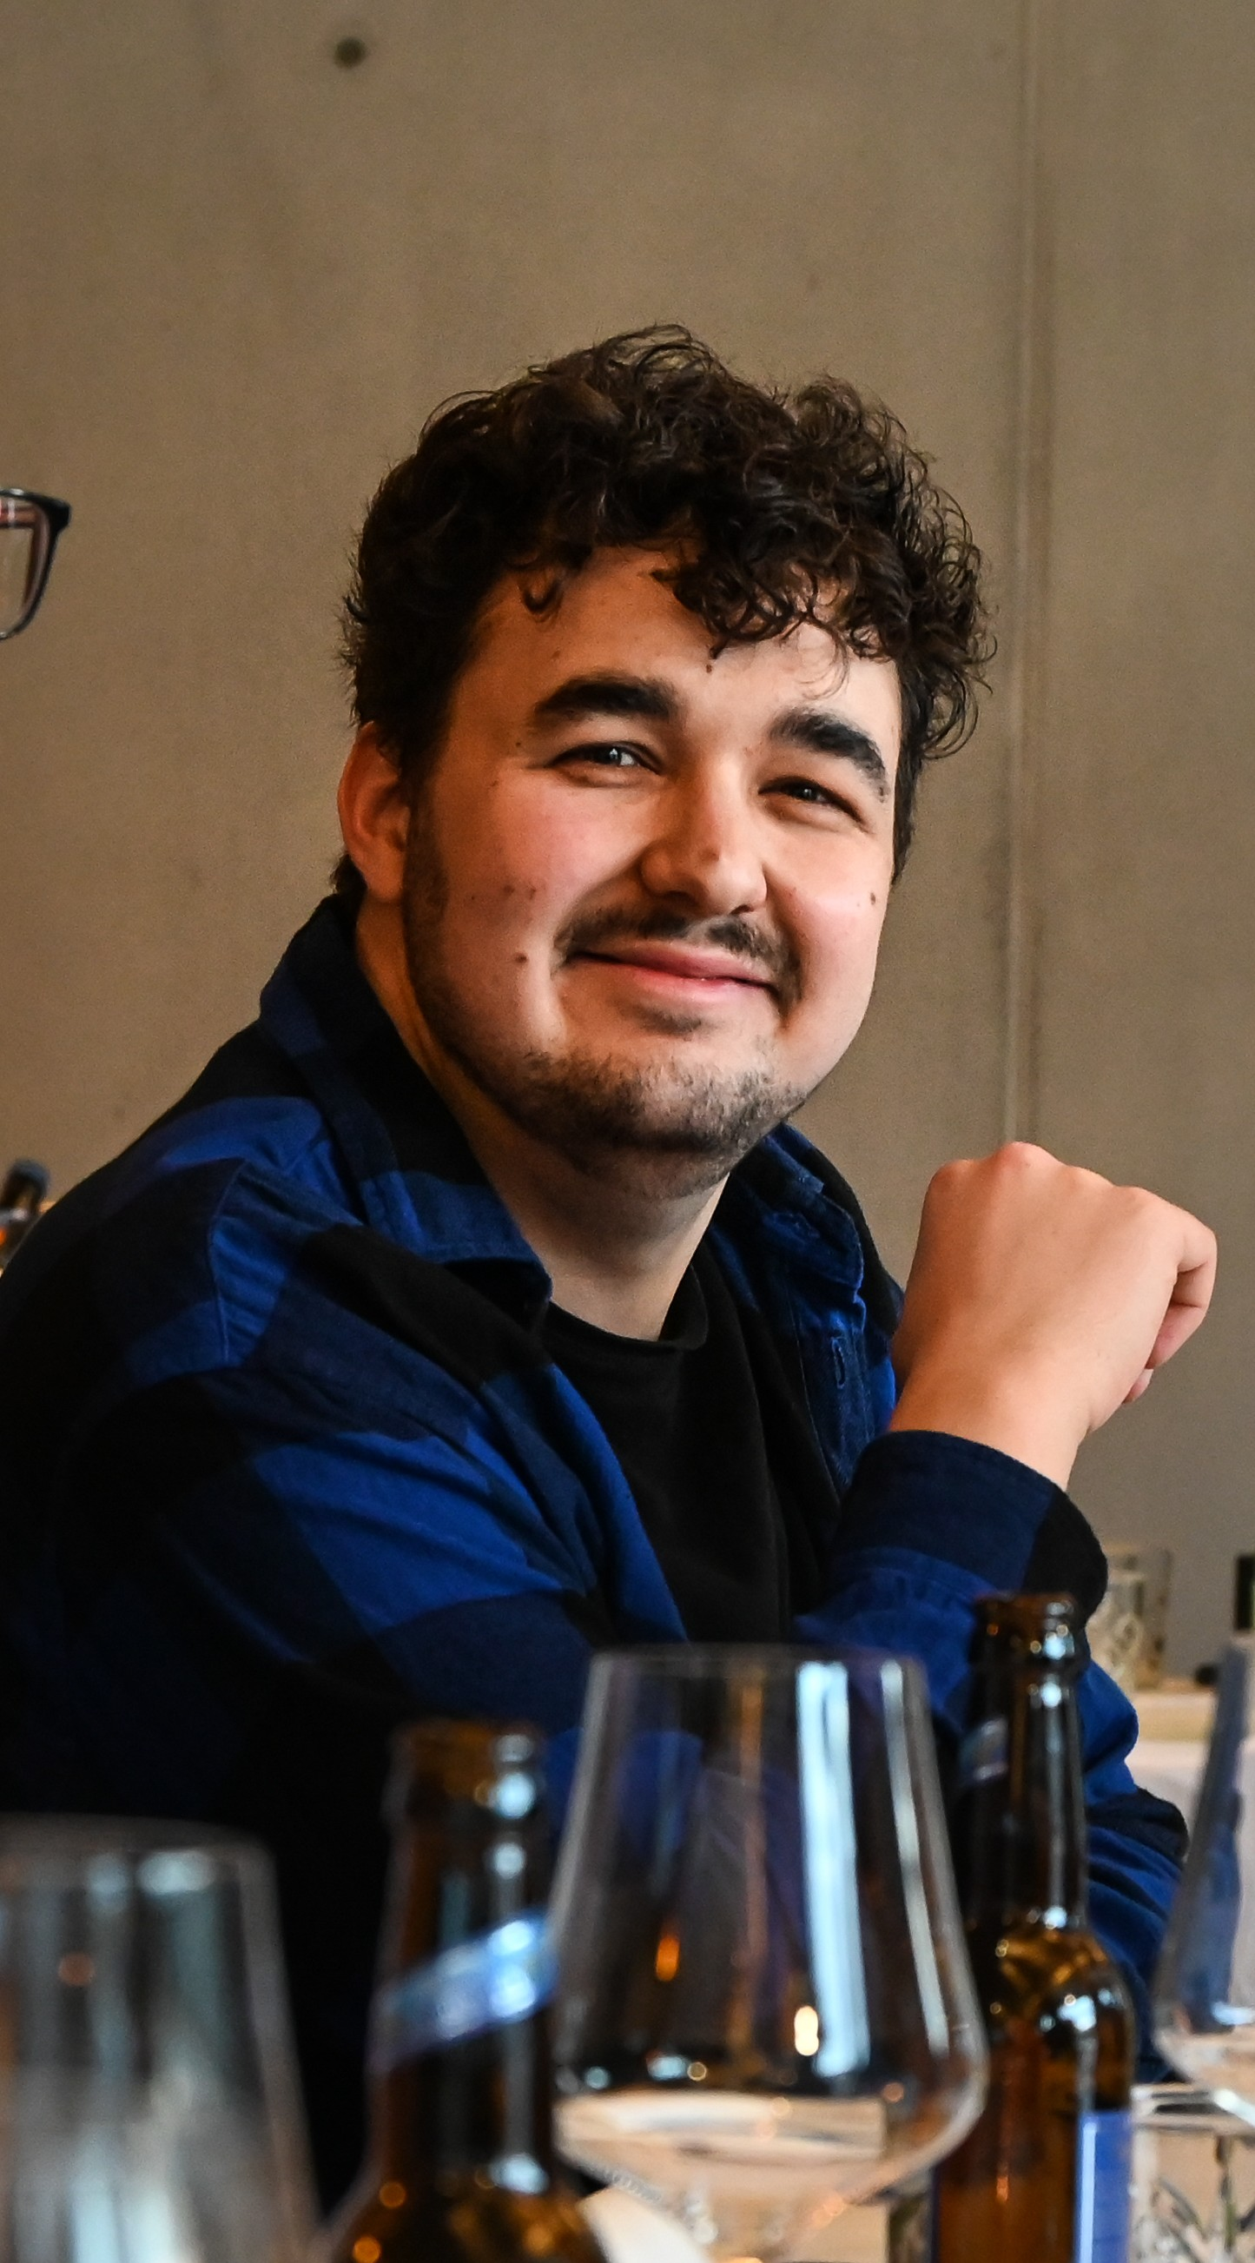




Nico Rudolph
University: Eastern Switzerland University of Applied Sciences
Study program: Computer Science
Year of study: 5th Semester
City: Rapperswil, Switzerland
Motto for life: Success favors those who prepare.
Hobbies: Padel, gardening, gaming, skiing
Your expectations from the summer school:
Learning beyond borders, collaborating with new peers.
Location where I live, work
and study
Karlsruhe
31 August to 11 September 2026

